Slide 1
Lecture
Networking
Packets, IPs, and Domain Names

Slide 2
What is a Network?
Two or More Devices Exchanging Information
Networks Require:
    A physical connection (medium)
    A language – software (protocol)
    Devices to facilitate

Slide 3

1: Physical Connection
Telephone / Network Lines
  Cat-3, Cat-5, Cat-5e, Cat-6
  T1
Cables
  Fiber Optic
  Coaxial
Wireless (air)
(a physical connection is also called a “medium”)
Notes:
Cat-3 – 10 Mbps – 1.2 MB/s – 1 hour to download a DVD (4.5 GB)
Cat-5 – 100 Mbps – 12MB/s
Cat-5e – 1000 Mbps (1 Gbps) <300 ft – 125 MB/s – 100 DVD an hour
Cat-6 – 1000 Mbps (1Gbps) >300 ft - 125 MB/s – 100 DVD an hour
Cat-7 – 10 Gbps – 1.2 GB/s – 1000 DVD an hour

Slide 4
Protocol - Definition
When computers communicate with each other, there needs to be a common set of rules and instructions that each computer follows.
An agreed-upon format for transmitting data between two devices.
A specific set of communication rules is called a protocol.

Slide 5
2. Networking Protocols/Software
PPP (Point-to-Point Protocol)
  dial-up connections
Ethernet
  used for local area networks (LANs)
802.11 b/g/n/ac
  short/long range wireless – 30 ft
Bluetooth
  personal-range wireless
Wi-Max – “Xohm” (Sprint/Nextel, Intel, Comcast, Time Warner) 802.16
  Enables usage across greater distances – up to 31 mi
  30 – 40 Mbps
  Distance vs. Speed
Notes:
B = 11 Mbps, G = 54 Mbps, N = 300 Mbps AC 1500 Mbps

Slide 6
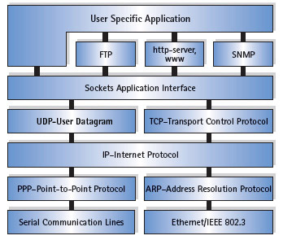
2. Networking Protocols (cont.)
TCP/IP (Part of O/S)
  Layered or suite of protocols for all commercial and private networks
  “TCP/IP is the glue that
  holds the Internet and
  web together”…
  (TCP/IP for Dummies)
Notes:
Transmission Control Protocol / Internet Protocol

Slide 7
Protocols you use everyday
Protocols within TCP/IP:
  DNS – Resolves www address to IP address (Domain Name system)
  FTP – Homework 4 – File Transfers (File Transfer Protocol)
  HTTP – Rules for all web-pages (Hypertext Transfer Protocol)
  IMAP – Rules for E-Mail (Internet mail access protocol)
  IRC –Internet Relay Chat – AIM, MySpace
  POP3 – Incoming Email (Post Office Protocol)
  SMTP – Outgoing email (Simple Mail Transfer Protocol)
  Telnet –Contacting computers remotely
  BitTorrent P2P sharing, Limewire, Kaaza
  List of Protocols

Slide 8
3. Networking Devices
Hubs and Switches
Routers
Modems
Radios (Wireless)
NICs (Network Interface Card)
NIU (Network Interface Unit)

Slide 9
3. Networking Devices (cont.)
Hub: This is the cheapest way to connect computers on a network. It's basically a box with several ports on it, one for each computer on the network. The hub helps transfer information from one computer to the other over the networking cables.
Switch: A switch is basically a better, faster version of a hub.
Router: The best way to connect your computers, especially if you plan to add a high-speed modem to the network, is with a router. The router not only connects the computers but also helps wisely manage them. It also helps put up a firewall between your computer network and the Internet.

Slide 10
Networking Matrix
Network | Medium | Protocol | Device
Dial-Up | Telephone Line | V.90 | Analog Modem
DSL | Split Signal Telephone Line | PPPoE | DSL Modem
LAN | Cat-5 Cable | Ethernet | NIC
Wireless | Air | 802.11/x | Radio
Cable | Coaxial Cable | Ethernet | Cable Modem
Cellular | Air | CDMA | Radio

Slide 11
Speed Chart – Pros/Cons
Dial Up | 2400 bps – 56Kbps | Cheap – Slow
Cable | 512 KBps – 100 Mbps | Must have existing cable Shared bandwidth
DSL | 129 Kbps – 8 Mbps | Dedicated bandwidth, not shared
Wireless | 54 Mbps + | Can be used for high speed data such as broadcast TV
Satellite | 6 Mbps + | High setup fees
Fiber | 15 Mbps – 500 Mbps | Good for high bandwidth demands - Multitasking
T-3 ( 28/T-1’s $3k/monthly) | 44.736 Mbps | Large businesses and ISP (static IP)

Slide 12
Types of Networks:
PAN – Personal Area Network
Peer to Peer*
LAN – Local Area Network*
CAN – Campus Area Network
MAN – Metropolitan Area Network
WAN – Wide Area Network*
Notes:
Bold – 3 main
Others more often referenced and used in recent years
PAN – using bluetooth
CAN – reference Pacific

Slide 13
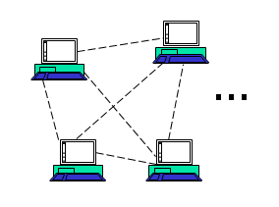
Peer to Peer Network
All members have equal rights
Each member authenticates users
Typical of home or small offices
Inexpensive and easy to set up
Also called a “Workgroup”

Slide 14
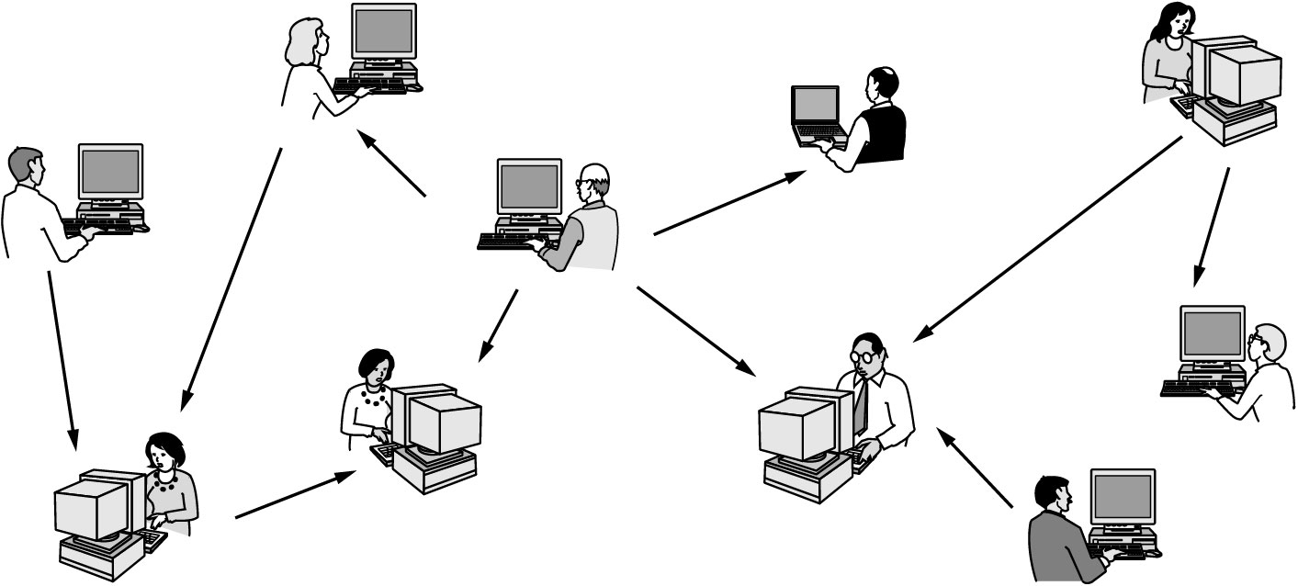
Peer-to-Peer Networks – Cont.
In a peer-to-peer system there are no fixed clients and servers.

Slide 15
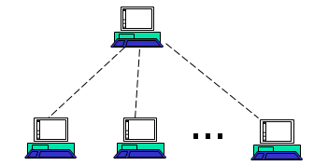
Client / Server Network LAN
Local Area Network
Server(s) for special applications
  Printing
  File Sharing
Single login authentication
Typical of campus or enterprise networks
Expensive servers and software best for large number of users
Also called a “Domain”
Managed services

Slide 16
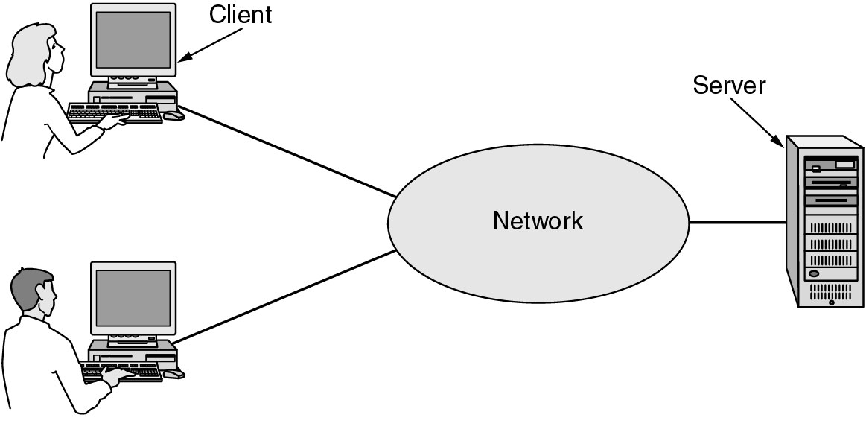
Client Server Networks
A network with two or more clients and one server.
FTP client enables “client” to contact “server”

Slide 17
The Internet – WAN
Wide Area Network
An interconnected network of smaller networks
  Schools and Government
  Commercial Entities
  Residential Users
  Access Providers
Common set of mostly-open protocols

Slide 18
Internet History -- WAN
1957: Sputnik launched
1958: ARPA formed under DOD
  “Come up with a bomb proof network”
1961: Packet Switching
  Network Protocol, precursor of TCP
  (cont)

Slide 19
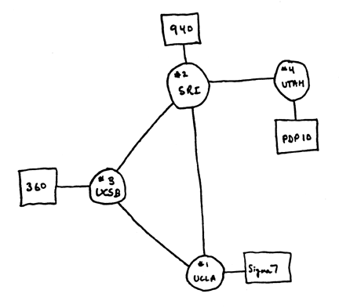
First Internet: 1969
Stanford 12KB of RAM

Slide 20
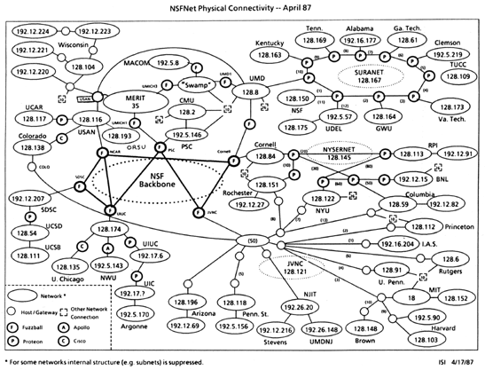
First Internet: 1969
Stanford #1: 12KB of RAM

Slide 21
Internet History (cont)
1975 First Email sent
1978 First Virus
1986 NSFnet
1988 First Chat
1989 First “commercial email”
1990 ARPANET ceases to exist
1991 Gopher = Search tool
1991 WWW is developed by Tim Berners-Lee
1993 Mozilla, Mosaic; Netscape

Slide 22
Packet Switching at the core of TCP/IP
Robert Kahn & Vint Cerf
  Fathers of the Internet
  Vint Cerf is currently Google VP and Chief Internet Evangelist
Kahn and Cerf collaborated to develop internet protocols
Collectively referred to as TCP/IP

Slide 23
Packet Switching
In packet switched networks (like the internet), data is split up into packets
Each packet is labeled with the complete destination address and routed individually
Packets are routed between nodes, across a variety of links, to reach their destination

Slide 24
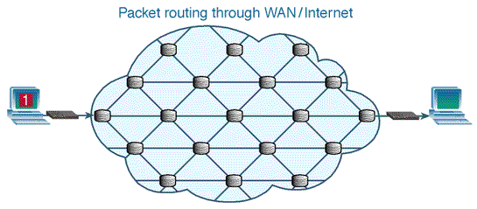
Packet Switching

Slide 25
IP Addresses
IP = Internet Protocol
Used to distinguish devices on a network
  Computers, Routers, Printers
Similar to postal addresses or telephone numbers

Slide 26
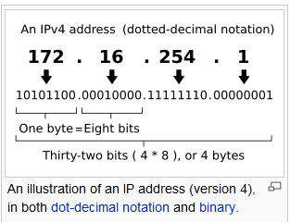
IP Address Syntax
Four consecutive 8-bit numbers
  From 0 to 255, four times over
  Read as ###dot###dot###dot###
Examples:

Slide 27
IP v4 Addresses: 32 bit number
IP Address 209.72.36.4
128 | 64 | 32 | 16 | 8 | 4 | 2 | 1
1 | 1 | 0 | 1 | 0 | 0 | 0 | 1
128 | 64 | 32 | 16 | 8 | 4 | 2 | 1
0 | 1 | 0 | 0 | 1 | 0 | 0 | 0
128 | 64 | 32 | 16 | 8 | 4 | 2 | 1
0 | 0 | 1 | 0 | 0 | 1 | 0 | 0
128 | 64 | 32 | 16 | 8 | 4 | 2 | 1
0 | 0 | 0 | 0 | 0 | 1 | 0 | 0

Slide 28
Limits of IPv4
32 bit addresses leave only 4 GB total IP addresses for all devices on the planet 2³²
Ran out of IP addresses by 2008
IPv6 Introduced June 2008 with 128 bit addresses 2^{128 or}
(approximately 340 undecillion or 3.4×10³⁸)

Slide 29
New IP addressing IPv6
Unlike the familiar IPv4 addresses which are 32 bits long, written in decimal, and separated by periods, IPv6 addresses are 128 bits long, written in hexadecimal, and separated by colons. An example would be:
3ffe:1900:4545:3:200:f8ff:fe21:67cf
Note: *You may see both IPv4 and IPv6 notations in your HW and lab since IPv6 has just begun implementation in 2008

Slide 30
IPs: Public and Private
Public (external) :
  Part of the internet system of IPs
  Assigned from ICANN or your ISP
Private (internal) :
  Part of an internal network of IPs
  Assigned by network admin or a router
  Generally inaccessible from the internet
  Communicates with Public via “NAT”

Slide 31
Range of Private IP addresses
Addresses assigned by Router
IANA Reserved Private Network Ranges | Start of range | End of range | Total addresses
24-bit Block (/8 prefix, 1 x A) | 10.0.0.0 | 10.255.255.255 | 16,777,216
20-bit Block (/12 prefix, 16 x B) | 172.16.0.0 | 172.31.255.255 | 1,048,576
16-bit Block (/16 prefix, 256 x C) | 192.168.0.0 | 192.168.255.255 | 65,536

Slide 32

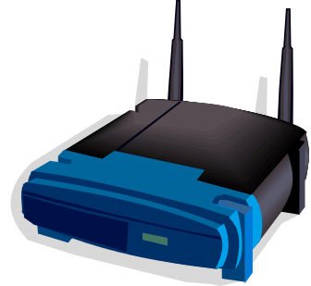

Network Address Translation
192.168.0.101
192.168.0.102
Your ISP
192.168.0.103
209.142.40.250
192.168.0.104

Slide 33
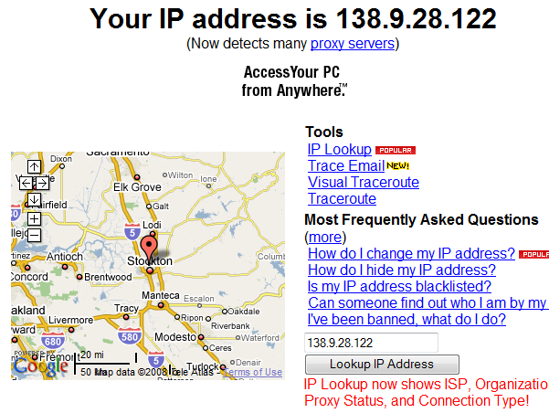

What is my IP address?
Could be the IP address of a computer or the router

Slide 34
How does it all work?
How do we navigate from one network to another on the Internet without know IP addresses?
Do we need to know all the IP addresses of all computers or devices?
How can I possibly memorize every IP address?
That’s where DNS comes in!

Slide 35
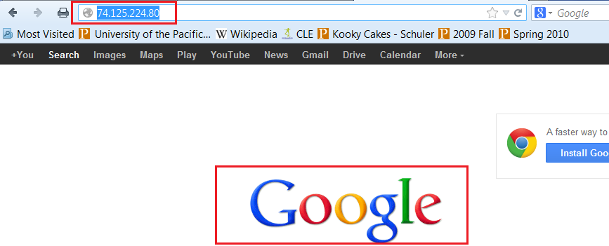
Why Do Domains Exist?
Better than typing an IP address
Which is easier?
  74.125.224.80/ or www.google.com?

Slide 36
Domain Name System (DNS)
A system whereby domain names are resolved into IP addresses
Servers all over the world act as directories for various parts of the internet
Ultimately, only one DNS server is authoritative for a domain – others simply refer to it
A DNS server can be authoritative for one domain or thousands

Slide 37
Who Controls DNS?
ICANN – Internet Corporation for Assigned Names and Numbers
Controls TLDs, many internet protocols, and the assignment of IP addresses.
TLD List

Slide 38
Parts of a Domain
Domains identify a network
Hosts identify a server on that network
TLD’S - Top level domains
http://www.pacific.edu
pacific.edu = domain
www = host

Slide 39

What’s a Domain Name?
protocol
domain
filename
host
directory
URL
A domain name is a name given to a collection of network devices that belong to a domain which is managed according to some common property of the members or within a common administrative boundary

Slide 40

How DNS Works
www.pacific.edu
209.54.38.201
ICANN
138.9.110.21
www.pacific.edu?
4.89.8.43
Your ISP
209.54.38.*
<HTML><TITLE>Welcome...
138.9.110.12
pacific.edu?
www?
Pacific
209.54.38.2
138.9.110.12
138.9.110.21
138.9.110.*
Notes:
Here we will see how the Domain Name System (DNS) works using a typical example. In this illustration is you, a typical user, ready to surf the internet from home.
In the lower-left is your ISP (Comcast, AT&T, etc). Your ISP has been assigned the IP netblock 209.54.38.*. Thus, the IP address they have given you is 209.54.38.201.
When your network was set up, your router was told to use Your ISP's DNS server for all domain name requests. In this case, that's 209.54.38.2.
In the lower-right is the Pacific network. You'll see that Pacific has two servers shown: a DNS server at .21 and a web server at .12.
And in the upper-right is the ICANN network with its master DNS server for the .EDU top-level-domain.
~Click~
You type into your browser the web address for Pacific: www.pacific.edu.
When you hit enter, your browser takes that website address and sends a DNS request down to your ISP. The request is a simple question: "Where can I find www.pacific.edu?"
~Click~
Since your ISP hasn't looked up that website in a while, it needs to get some help. It will go to the source, ICANN, and ask it where "pacific.edu" is. Remember that ICANN only knows where the domain is, not the hosts inside that domain.
~Click~
ICANN responds back with the IP address for the DNS server that is reported by Pacific to be responsible for all DNS requests in the pacific.edu domain. That server is at 138.9.110.21. The information is sent back to your ISP's domain name server.
Using your computer, visit Network Solutions and use WHOIS to look up pacific.edu.
~Click~
Now armed with this new information, your ISP's domain name server goes to 138.9.110.21 and asks it where "www" is.
~Click~
The Pacific DNS server responds back with 138.9.110.12, the IP address for Pacific's server called www. That information is sent back to your web browser.
Using your computer, ping www.pacific.edu and see what comes back. Or, try entering that IP address directly into your web browser as if it were a website you wanted to visit.
~Click~
Your browser now knows the exact IP address of the website it's trying to retrieve. It sends a packet directly to that IP address asking for it to deliver content for www.pacific.edu. It's important for your computer to specificy *which* website it's looking for, since a web server often hosts a wide variety of web sites and pages.
~Click~
The Pacific web server starts sending packets of data containing the HTML code which is put together to display a website.
Remember the reason this is so complicated is because there are millions of servers on the internet. This system allows organizations like Pacific to manage their own network without having to bother ICANN with little details. It also keeps in line with the internet's design methodology of not being centralized. Even if ICANN were to fall apart, your ISP could resort to another ICANN-like entity to resolve top level domains.
And, thanks to "caching", DNS entries go a lot faster. Now that your ISP knows where pacific.edu is, it won't need to query ICANN for some time. Likewise, your own computer will cache that data too for the next time you visit the site. (This can also cause a problem when a website moves from one server to another, or onto a completely new network.)

Slide 41
Internet Evolution
Search Tools
Internet 2.0
Content – Web 2.0
Notes:
Discuss – evolution of search tools, ease, graphically based, database connection
Internet 2.0 – upgrade of infrastructure – networking components on a large scale, ISPs
Web 2.0 – evolution in content, user-generated and driven as opposed to research/education/government/corporate info

Slide 42
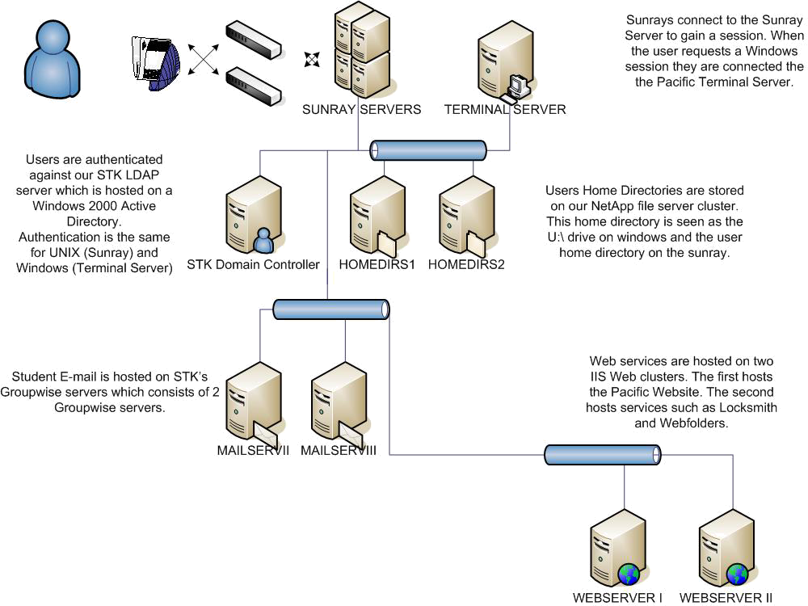
A Look at PacificNet
Notes:
Domain Controller – Windows; authenticates all log-ons at Pacific
**Domain – STK for Stockton, SAC for Sacramento; etc.
Sunray servers have been replaced with servers for VDI – which we use in classroom

Slide 43
Understanding Ports
A port is a doorway to a connection in the Internet world.
Part of TCP/IP layer –65,535 possible ports
Different layers of TCP/IP use different ports, eg:
Port 80 for web traffic
Port 21 for FTP
Port 25 for email
Port Table

Slide 44
Port Scanning & Malicious Probes
It is similar to a thief going through your neighborhood and checking every door and window on each house to see which ones are open and which ones are locked.
Port scanning software sends out a request to each port sequentially and makes a note of which ports responded or seem open to more in-depth probing.

Slide 45
Networking Commands
From CMD prompt
ipconfig /a Displays the network settings currently assigned and given by a network
ping: Determines if the network is able to communicate with the network
tracert: View a listing of how a network packet travels through the network.
nslookup: Look up an IP address of a domain or host on a network
netstat –b: Network status and ports in use.

Slide 46
More Commands
date – displays current date
help – shows possible commands
tasklist – displays current tasks/processes running on system
start – start program command

Slide 47
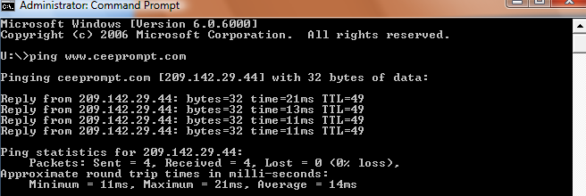
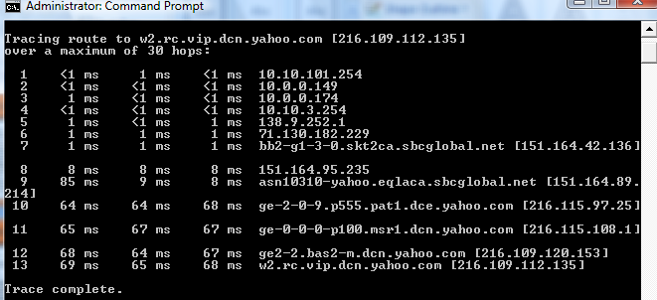
Windows/DOS Command Prompt

Slide 48
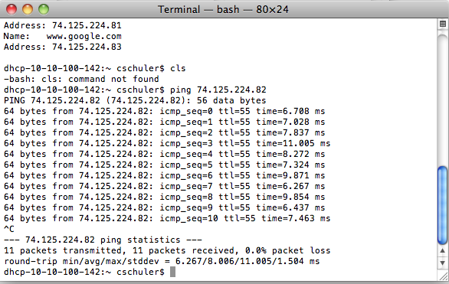
Mac: Terminal
Applications | Utilities| Terminal
Unix Networking Commands

Slide 49
WHOIS
Tells you the domain registrant and what server is authoritative for a domain
www.networksolutions.com/whois
IP WHOIS
  http://whois.arin.net
  Search for: 138.9.110.12
NSLOOKUP (Command Prompt) 138.9.110.12

Slide 50
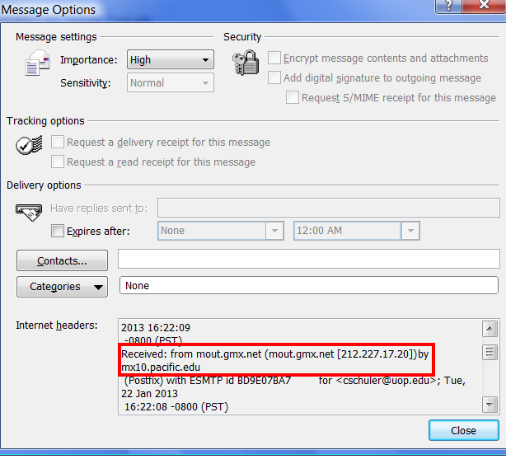
Using ARIN to track down Spam
Look at email
headers
Find sending IP
address
Lookup IP in ARIN
Copy header
Forward email with
header to
administrator
or abuse contact

Slide 51
Creating your own web presence
Need ISP – Internet Services Provider
  Secure dynamic or static IP addresss
Need a website address
  GoDaddy.com, Networksolutions
Need a host for your website address

Slide 52
ISP’s
Internet Services Providers
  Thousands! Look online or pursue the big companies such as ATT/Comcast
Pricing options vary by bandwidth and whether IP address you receive is static or dynamic
  Dynamic renews/refreshes – can be different
  Static IP never changes

Slide 53
Static or Dynamic IP Addresses
Static IP addresses are constant
  One IP address for one customer
  Useful if you host multiple web sites, or a gaming site
  Use VPN or VOIP
  Pricier
Assigns a different IP address with each login – or as ISP’s deem necessary
  More economical
  Less security risk

Slide 54
Domain Names
GoDaddy.com, NetworkSolutions.com
Companies OK’d by ICANN can sell domain names
Multiple TLD’s, available: .com .biz .net .ca etc
Must be renewed annually or at end of multi-year term.

Slide 55
Domain Hosts
A server that “hosts” your domain name.
Commercial or academic
Monthly hosting fees vary depending on size of site, number of emails,
Host provides UN and PW credentials for FTP access so pages can stay current.

